Slide 1
Module 2: Azure Machine Learning Experiments

Slide 2
Experiment Tracking

Slide 3
Data Science Building Blocks Project
Prepare data, train models
Hyperparameter tuning
Experimentation and pipelines
Deployment
Monitor and Retrain
Classical ML
Deep learning
Data
Data stores
Data sets
Managed Compute
Azure Machine Learning compute cluster

Slide 4
Experiment Tracking
Model training is an iterative process.
When experimenting, you may combine different features, hyperparameters, data samples, may try different ways of aggregation. and hence you have to keep track of what specific experiment set up led to what model performance to allow for comparison.
This does help you in three main ways:
it supports your model selection process
it helps steer your experimental process/direction
it allows for reproducibility.

Slide 5
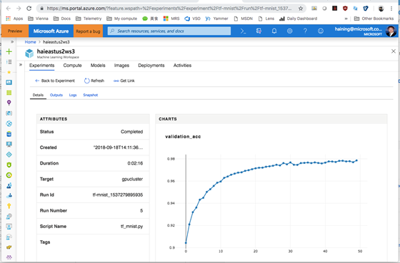
Tracking Experiments with Azure ML
The Experimentation capabilities of the Azure Machine Learning service help you to track experiment run results.
With Azure ML you can run an experiment locally or remotely, and use the logging APIs to record different metrics, or upload any file such as input/output datasets or rather modeling outcome artifacts e.g. a trained model.
When you a submit an experiment run through the Azure ML service, your code automatically gets snapshotted for you, allowing for reproducibility.

Slide 6
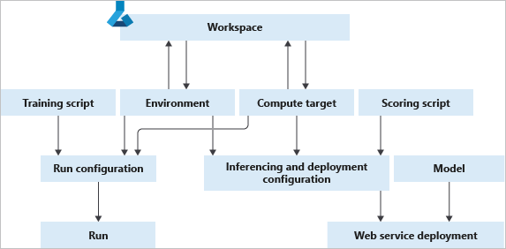
Creating an experiment run with Azure ML
Submitting runs with Azure Machine Learning enables the monitored execution of a run, either run on local or on cloud compute.
Runs are tracked against an Experiment, logically grouping the results of multiple runs.
A run’s tracked metric values and properties, such as run duration, are saved in the cloud service for later review or comparison.
Runs can be submitted either via the SDK (Python / R) or via the CLI.
A Run Configuration defines how and where a run is executed:
the environment in which an experiment run must be executed, helping to manage available data sources, environment variables and dependencies.
the training script and its dependencies.
a compute target

Slide 7
Demo: running experiments with Azure ML

Slide 8
Lab_02: running experiments with Azure ML

Slide 9
The 20 Newsgroups data set
The 20 Newsgroups data set is a collection of approximately 20,000 newsgroup documents, partitioned (nearly) evenly across 20 different newsgroups. To the best of my knowledge, it was originally collected by Ken Lang, probably for his Newsweeder: Learning to filter netnews paper, though he does not explicitly mention this collection. The 20 newsgroups collection has become a popular data set for experiments in text applications of machine learning techniques, such as text classification and text clustering.
Organization
The data is organized into 20 different newsgroups, each corresponding to a different topic. Some of the newsgroups are very closely related to each other (e.g. comp.sys.ibm.pc.hardware / comp.sys.mac.hardware), while others are highly unrelated (e.g misc.forsale / soc.religion.christian). Here is a list of the 20 newsgroups, partitioned (more or less) according to subject matter:
comp.graphics
comp.os.ms-windows.misc
comp.sys.ibm.pc.hardware
comp.sys.mac.hardware
comp.windows.x rec.autos
rec.motorcycles
rec.sport.baseball
rec.sport.hockey sci.crypt
sci.electronics
sci.med
sci.space

Slide 10
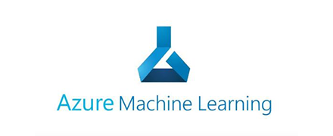

train.py
Conda_dependencies.yml
local
Training script
Environment
Compute
train_sumit.py
Run configuration
logs
Submit run
Experiment

Slide 11
Train_15models.py
Conda_dependencies.yml
local
Training script
Environment
Compute
train_15models_sumit.py
Run configuration
logs
Experiment
Submit run
Parent run
Child runs

